Slide 1
ONLINE EDUCATION PLATFORM
Mini Web Project
Group member:
HE XUANRAN/G2002017H
ZHANG MENGTIAN/G2001384F

Slide 2
Outline
01.
Project Scenario
02.
Project Features
03.
Database Design
04.
Main Technology

Slide 3
Project Scenario

Slide 4
Project Proposal
To prevent the further spread of COVID-19, offline teaching is becoming increasingly difficult. We launch an ONLINE EDUCATION PLATFORM(OEP) to create a convenient learning environment for NTU students.
The ONLUNE ENUCATION PLATFORM(OEP) aims at increasing students’ interest in learning. For this purpose, we provide a variety of learning resources covering computer, humanities, art and other fields.
Students can choose their own study materials and manage their courses on our platform, which will not only make study easier for them, but also help them explore the boundaries of their skills.

Slide 5
Project Modules
“

Slide 6

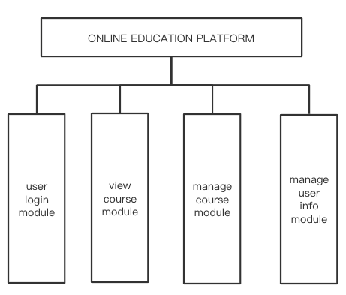

Slide 7

Project Features

Slide 8
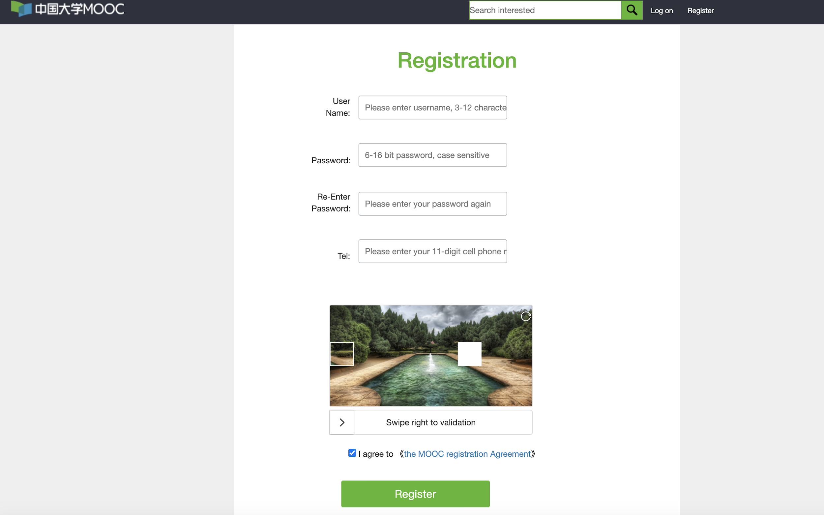
Feature Presentation
Register：A new user should use their username, password and telephone number to register OEP system. We use double check for this part if there is anything wrong or blank, the registration won’t be approved.

Slide 9
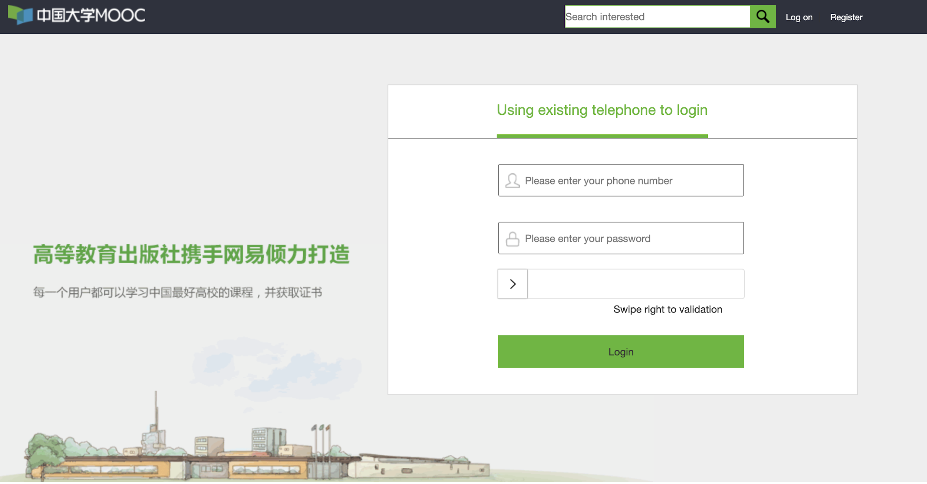
Feature Presentation
Log in: Old users use their username and password to log in. Here we do a password encryption by using MD5 technology.

Slide 10
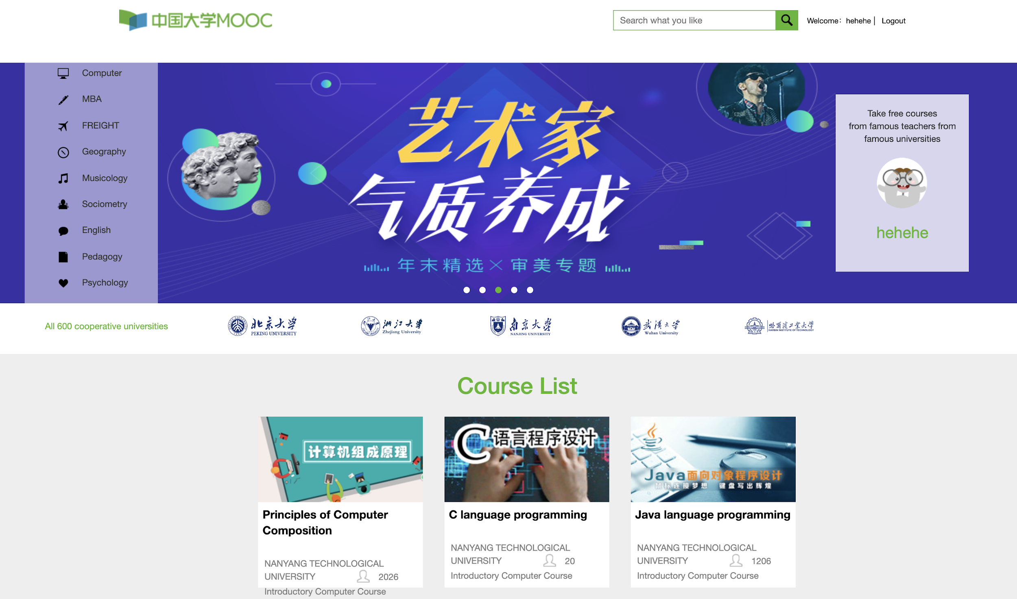
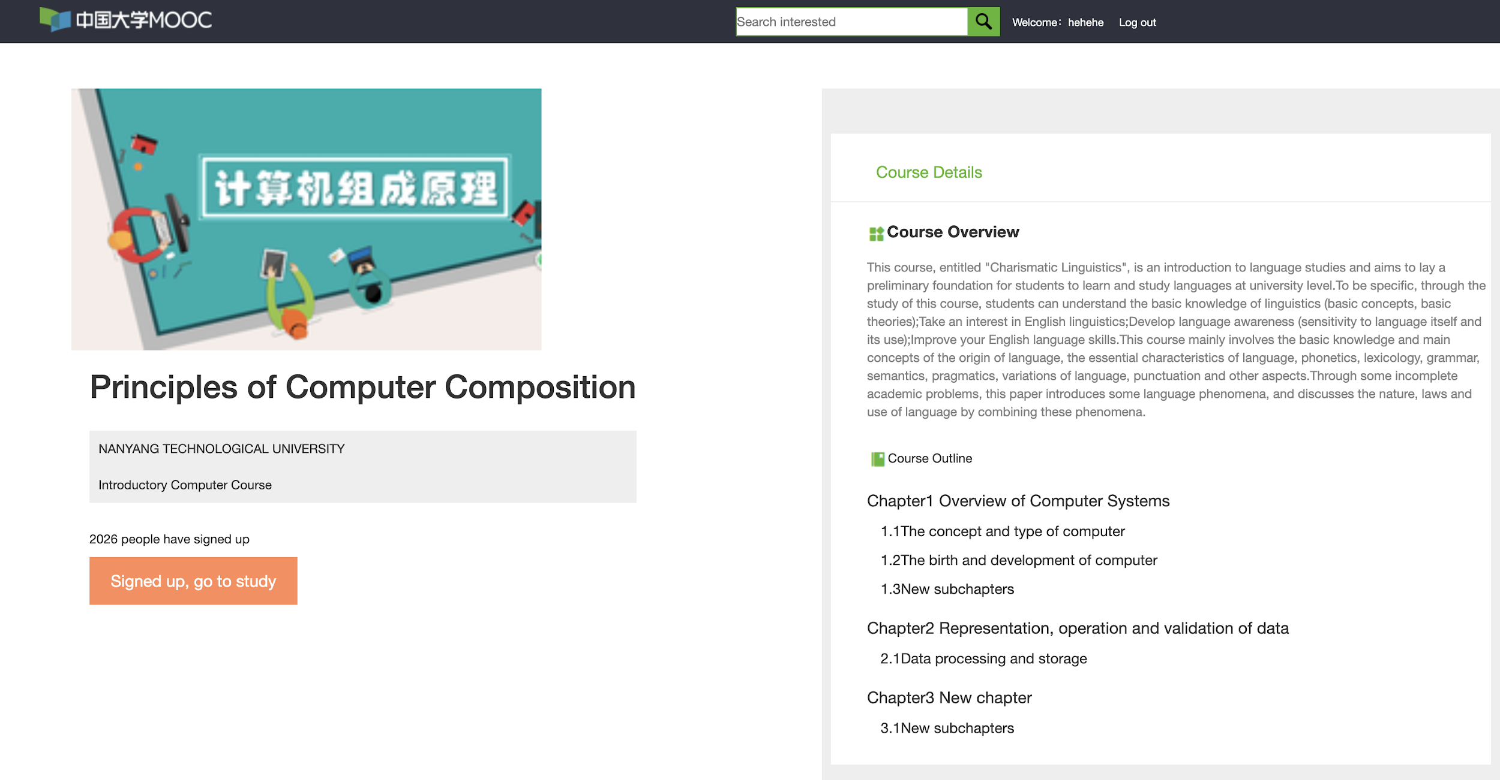
Feature Presentation
Course details: When users find a course they like, they can click on the course name for details. In this page, users can see how many people have attended this course and read the overview and the outline of this course to determine whether to choose or not.

Slide 11
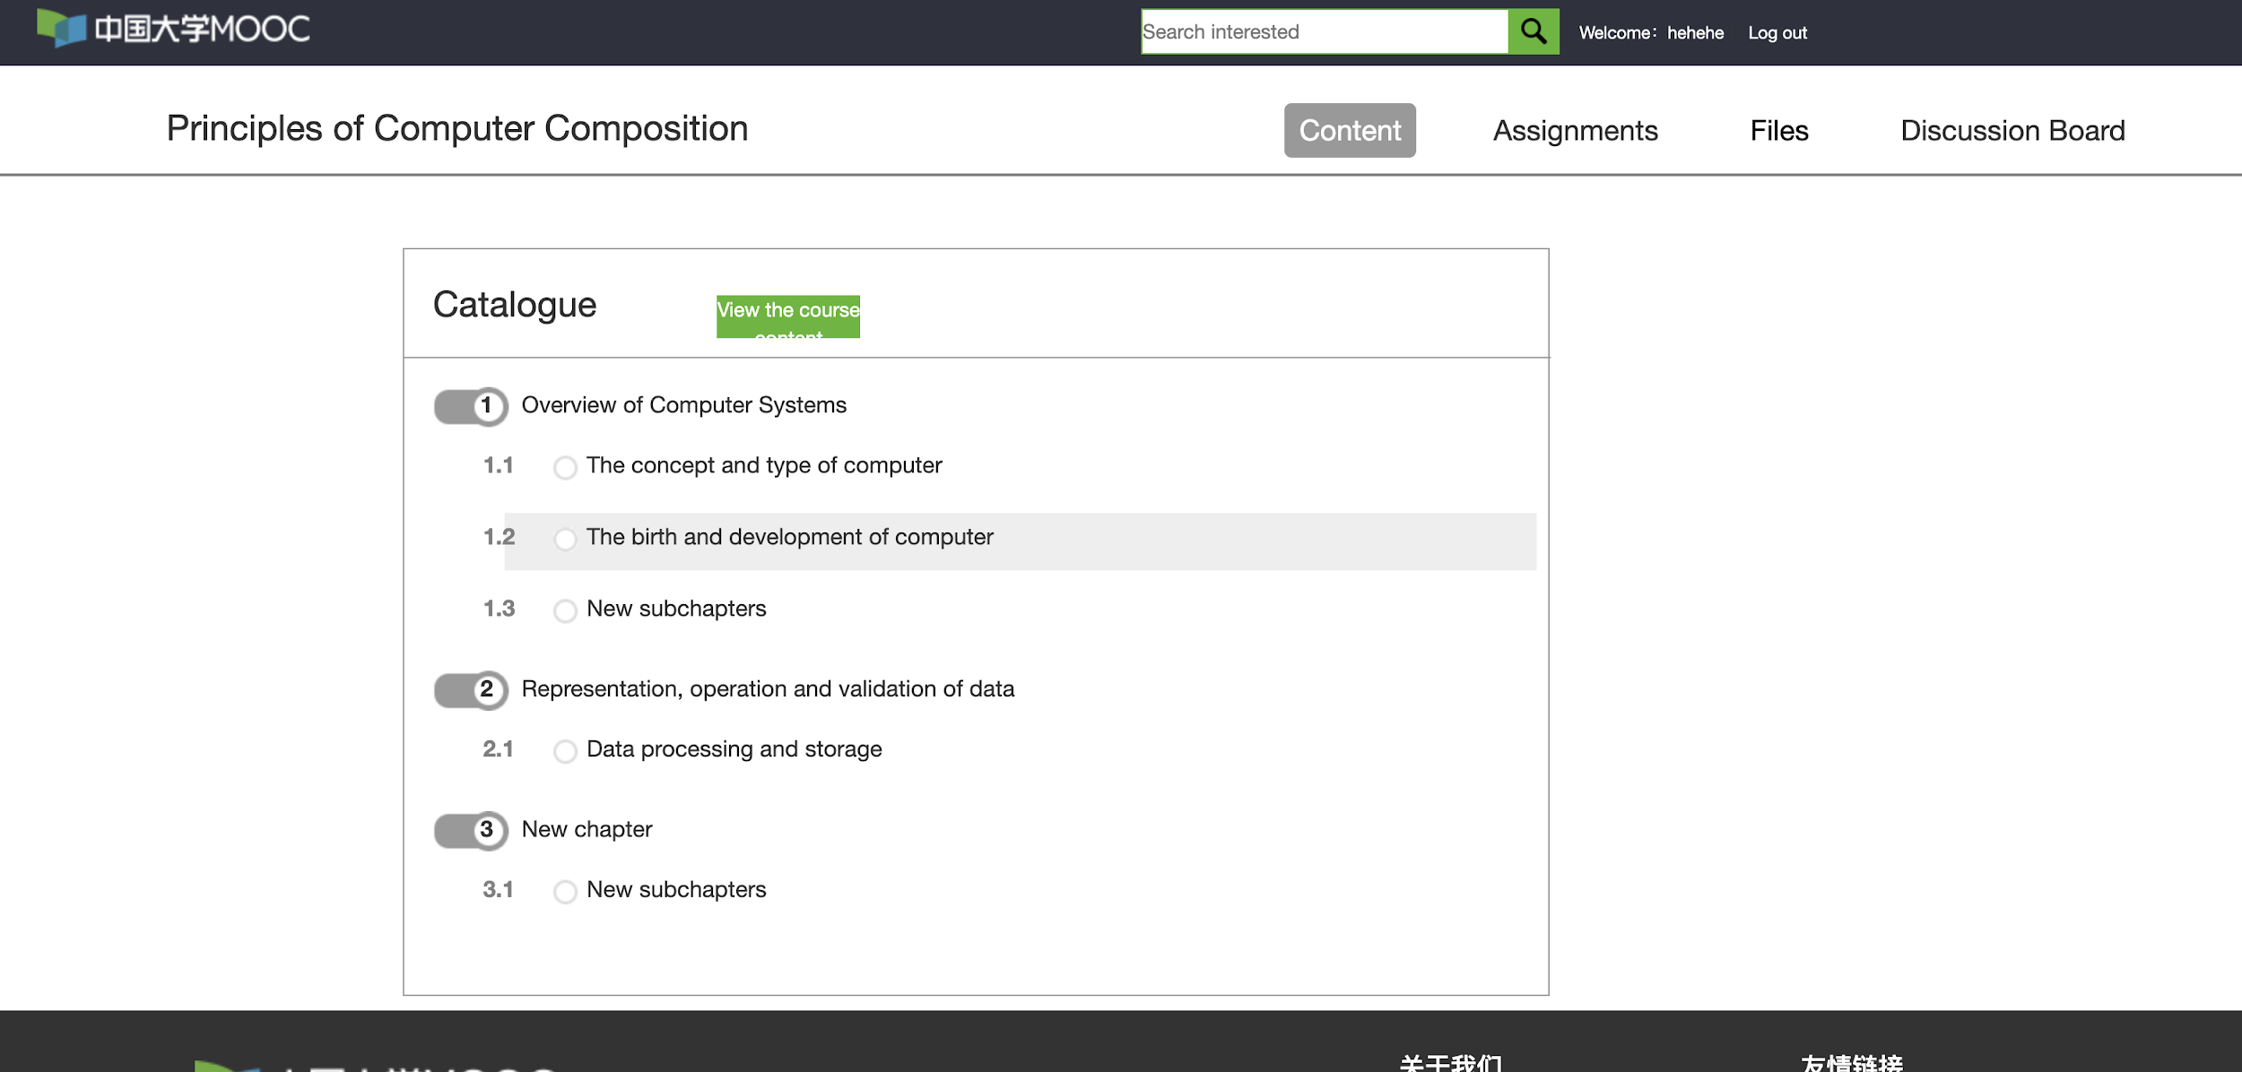
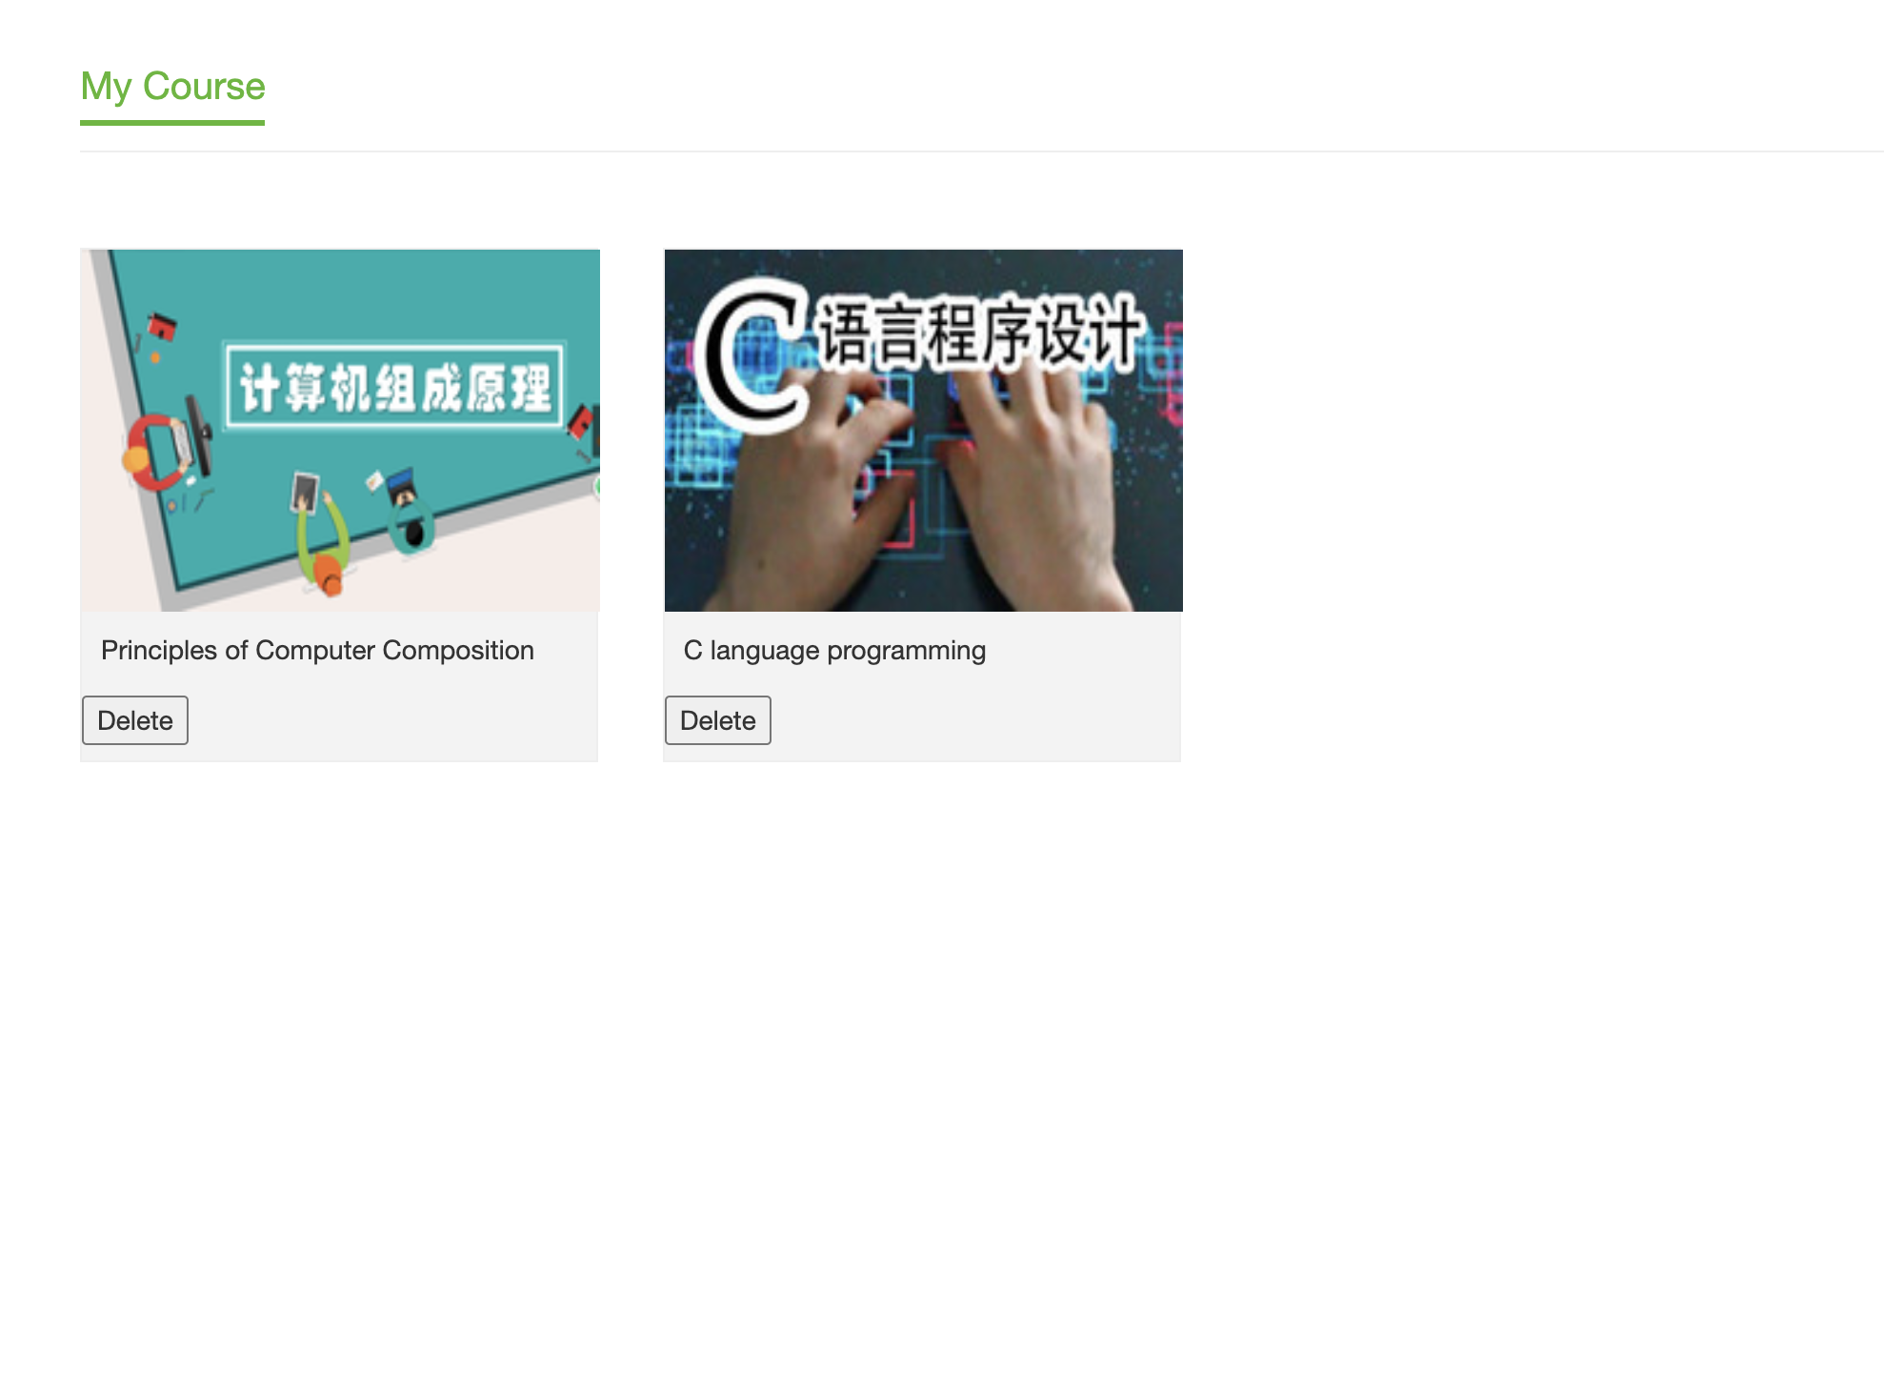
Feature Presentation
Attend course and manage courses: After click ‘Immediately to attend’, users will enter the profile page and see all the courses that was selected. Click the course name users will see the ‘Content’, ’Assignments’, ‘Files’, ’Discussion Board’. After attending, users can also delete the course if they like.

Slide 12
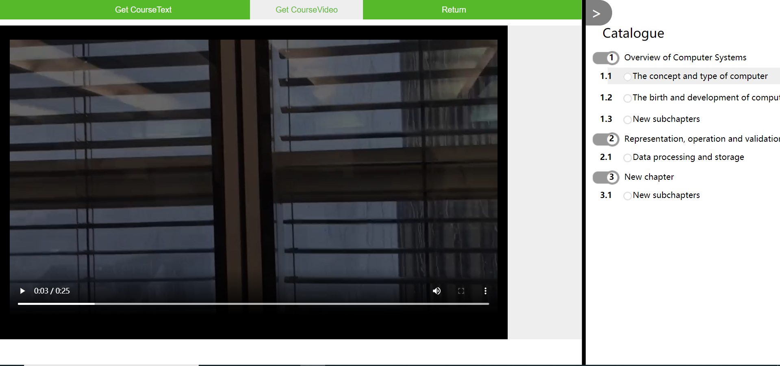
Feature Presentation
Play the course video：When users click ‘View the course’, they will start course study. In this page, they will see the course text and play the videos.

Slide 13
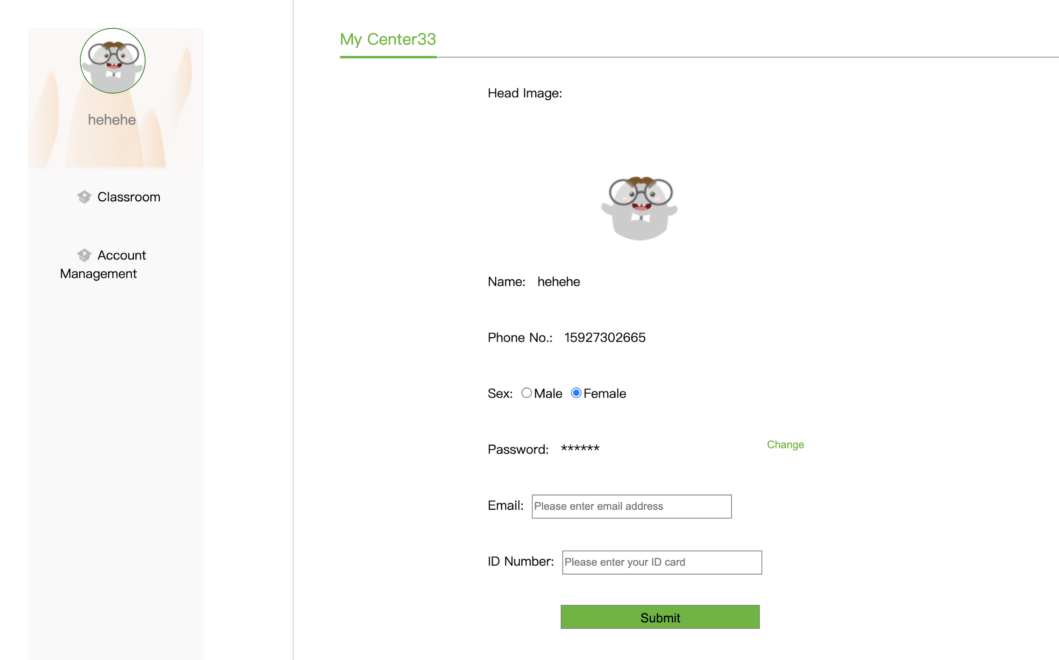
Feature Presentation
Profile Page: If users want to change their password or avatar, they can enter the profile page to do this operation.

Slide 14
Database Design

Slide 15
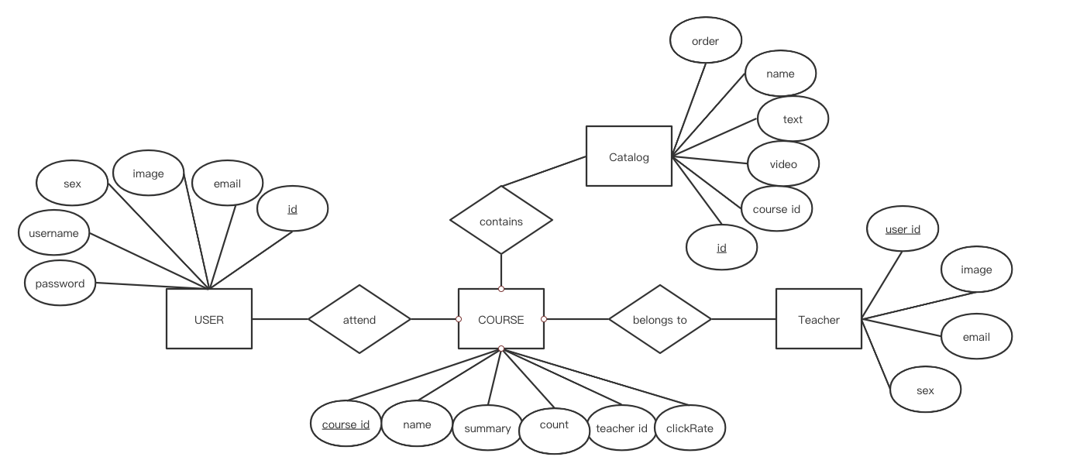
ER Chart
Notes:
Use D3 to divide and project the selection of the GE2020 general election on a map that refers to the real world.
Modify JSON file to display the boundaries of each district in selection.
Add new attributes in JSON file to allow each region displaying different color darkness according to the popularity of the winning party. Write the function to analyze and process the boundary to display the name in the center of each constituency, which would make the information more understandable.
Finally, we keep the mouse-move in and out function, which could provide more information when mouse move in, in order to provide a better human-computer interaction experience.
At the data level, the map integrates the data of boundaries, names, winning parties, the popularity of the winning parties, and the distribution of the national constituencies. The map also displays them in a very brief way. For example, It is clear in the figure that the Worker’s Party only won in three regions, and winner of the other regions is the People's Action Party. In some regions like Bukit Batok, it can be said that PAP has won overwhelming victories.

Slide 16
Main Table
COURSE
USER
Field | Type | Length | Comment
id | INT | 11 | PRIMARY KEY
coursename | VARCHAR | 255
coursesummary | MEDIUMTEXT
count | INT | 255 | User participation
courseimg | VARCHAR | 255
courseintroduce | VARCHAR | 255
teacherid | INT | 11 | 0 VALID/1 INVALID
clickRate | INT | 11 | Course clicks
Field | Type | Length | Comment
id | INT | 11 | PRIMARY KEY
headImg | VARCHAR | 100
username | VARCHAR | 20
telephone | BIGINT | 20 | UNIQUE KEY
password | VARCHAR | 255
state | INT | 11 | 0 VALID/1 INVALID

Slide 17
Main Technology

Slide 18
We use a Model-View-Controller architectural pattern. Besides, we introduce a DAO layer to design some API that can connect to the database.
We use a MD5 algorithm to encrypt the password. In our user_login_info table, you can only see anonymous password.

Slide 19
THANKS!
Contact info:
XHE015@ e.ntu.edu.sg
MZHANG035e.ntu.edu.sg

